Slide 1
join our
LAUNCH
investment opportunity

Slide 2

We are PinDo
Pin
Verb. The act of posting a task.
intend
plan
list
resolve
aim
An online services marketplace empowering local communities to accomplish projects and everyday tasks.
Simplify your life, PinDoit.
Do
Verb. To complete, accomplish.
achieve
finish
take care of
pull off
sew up

Slide 3

TOC
investment
team
We are PinDo – mission statement
What we want – our offer terms
How did we get here – discovery
A ha! – the idea
Let’s make a business – market opportunity
The challenge – competitive review
We are different – our solution
Appendicies – due diligence documentation
due diligence
the idea

Slide 4
Term Offer
We are seeking a
$XXX investment
In exchange for %XXX
of our company
Capital will be used to support launch activities including marketing efforts
and product development associated with the opening of business in
Fairfield, Connecticut.

Slide 5
Enormous market opportunity
$800 billion
Local consumer services market ¹
37 million
Households nationwide earning more
than $75K annually ²
¹ BIA Kelsey, Sizing the Local On-demand Economy, February 2017
² IRS ZIP Code Data, 2015

Slide 6
How did we get here?
work
family
repairs
self-improvement
coaching
projects
QUALITY OF LIFE
NECESSITIES
VS.

Slide 7

A ha!
Trusted
Professionals
Local Service
Providers
Endorsed by
Friends
One-stop
Shop
Online
Services
Marketplace

Slide 8

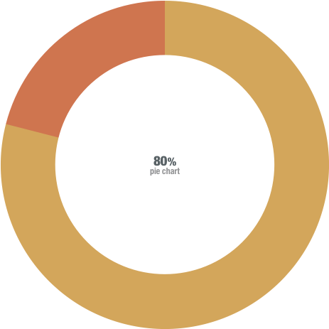
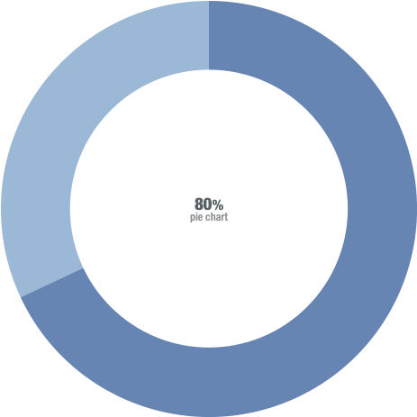
Let’s make a business
Service Providers
Customers
^{LOCAL}
^{is key}
79%
68%
Important to work locally
Important to hire locally
PinDo prospective customer survey, Survey Monkey, 2018

Slide 9

The challenge
Fragmented local marketplaces negatively impact both consumers and service providers.
Consumers have difficulty locating and contracting talent appropriate for their project needs.
Service providers cannot focus their sales and marketing efforts.

Slide 10


Consolidate the local marketplace through practices that promote trust and value
Create an equitable, mutually beneficial profitable business model for both service providers & customers

Slide 11



Empower, simplify, clarify
Empower = enable direct consumer selection of service providers
Simplify = easy booking, straight-forward fee models
Clarify = honest, true merit-based ratings, social network reviews

Slide 12

Solution
It’s simple… connect Pinners and Doers… save time, find experts, improve your lifestyle
+
=

Slide 14
Appendix
Competitive analysis
Survey results
Product diagram
Product categories
Consumer benefits
Service provider benefits
Launch & growth strategy
Revenue model
Financial forecast
Team

Slide 15







Competitive Analysis
The Players
Home & Lifestyle
Services Categories
National Marketplace
Model
City Marketplace
Model
Local Marketplace
Model
Payment on Platform
Customer Selection of
Service Provider
Social Networking
Merit-based Reviews

Slide 16
Survey Results: Service Providers
79%
86%
49%
92%

